Slide 1
3 Levels
Node level: Actor/Agent
  Centrality, Propensity, Attributes
Dyad: Social tie formation and decay
  Reciprocity, Strength, Similarity (Social Distance)
  Underexplored because of data limitations
Triadic level: Communities
  Transitivity, clustering (social closure), embededness

Slide 2
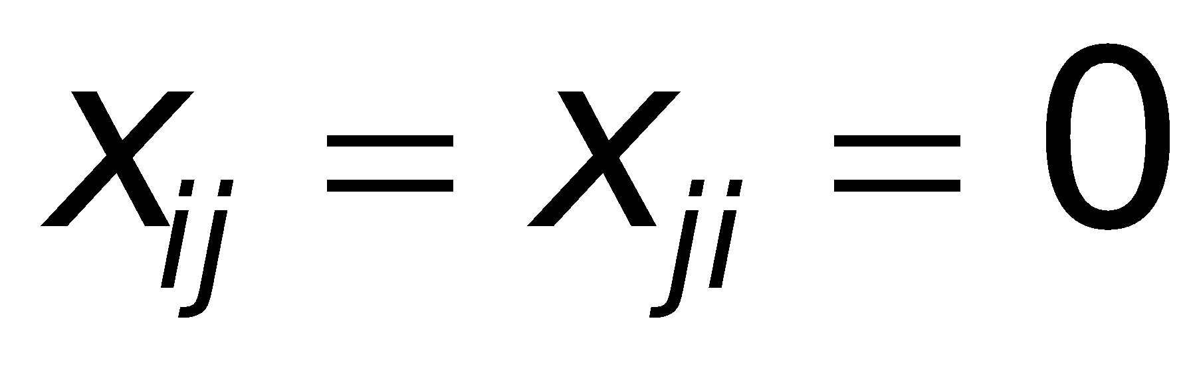
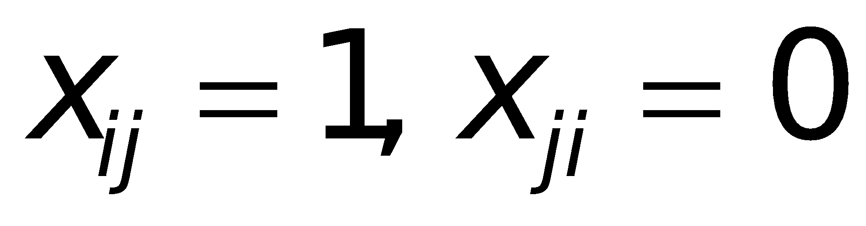
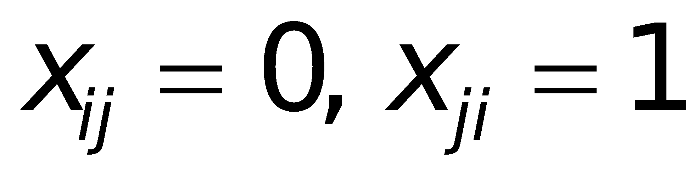
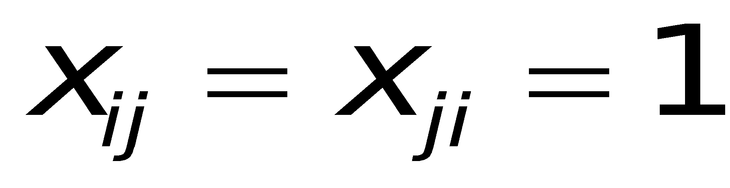
Dyadic Census: Limitations of Binary Data
Null Dyad
Asymmetric Dyad
Asymmetric Dyad
Mutual Dyad
With only binary data, oversimplified contrast between asymmetric and mutual pairs
Mutual dyads can be non-reciprocal
Among mutual dyads there can be variability in the level of reciprocity
Need to bring in intensity of tie (weighed edges)
‹#›
Notes:
Dynamic view to explore the dyad level.
‹#›

Slide 3
Flow Metaphor
Ties and Flows
  Over (or within) ties there are flows
  Strong ties: Large flows (bandwidth)
  Reciprocal ties: Balanced flows
Need measures of both
  direction of flow
  intensity of flow
Notes:
‹#›
FRIENDSHIP CHOICE
E.g. A chooses (says) that B is A’s friend Maureen & Rich
Sparse matrices, lots of null dyads.

Slide 4
Social Network “Flows”
Dyadic social interactions (playing tennis, having sex, talking with, colloborating together on, exchanging with, giving to, receiving from)
  Event counts within a time window
  Event traits: initiating, waiting times, sequencing
Communicative Interactions
  Initiating, who provides information, time talking, length of messages
Reciprocity as
  Balanced counts aggregated from information on the occurrence and traits of interactional events within a time window
  A temporal event sequence A->B->A->B
Notes:
trade networks: eschanges
communication network: communicative interactions
neural network: electronic charges
sex network: sexual interactions (diseases)
Ties = Pipes, Tubes, Wires
Flows = Liquid moving through, electricity, pathogen
‹#›

Slide 5
Directed Weighted Edge Graphs
    Arc: x_{ij} = 1 if there was an interaction between i and j within a given time period and i initiated that interaction (e.g., a call from i to j)
    Outflow Parameter: Count of the number of interactions between i and j that were initiated by i in a given time period (e.g., number of calls made by i to j)
x_{ij}
m_{ij}
2
5
x₁₂ = x₁₃ = x₁₄ = 1
1
3
3
m₁₂ = 5
m₁₃ = 3
m₁₄ = 1
1
4
‹#›
Notes:
present data about the counts
theorizing at the event level, and will be able to look at things at that level (though lots of noise there ), and model with ABM and simulations
What you really want in a communication network is not initiation, but value content flows
‹#›

Slide 6
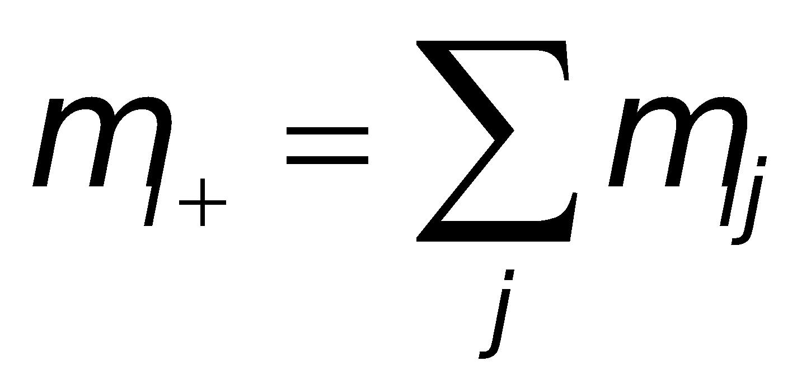
Node Level Properties
    Out-degree of node i, i.e. count of number of j nodes that i has initiated interaction with in a given time period (e.g., number of people i called)
    Vertex Strength (activity level of a node): Count of the number of interactions initiated by i with all i’s j neighbors in a given time period (e.g., total number of calls made by i)
d_{i}
m_{i+}
2
d₁ = 3
5
1
3
3
1
m₁₊ = 5 + 3 + 1 = 9
4
‹#›
Notes:
‹#›
also think of mij as strength of tie , i.e. arc, ie. directed tie. ( relative to max mij???)
3 strengths:
Vertex strength
Arc Strength ( “best friend”)
Edge Strength (Bandwidth)

Slide 7
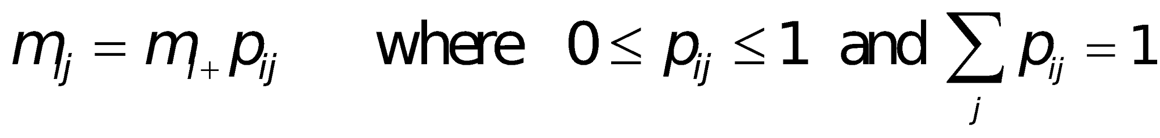
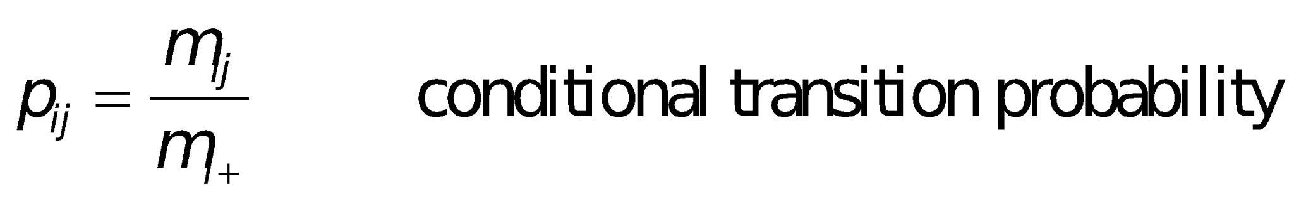
Arc Flows & Vertex Strength
2
m₁₂ = (m₁₊) (p₁₂)
5 = 9*(5/9)
5
1
3
3
1
p₁₂ = 5/9 = .556
p₁₃ = 3/9 = .333
p₁₄ = 1/9 = .111
4
‹#›
Notes:
‹#›
aggregated data over a discrete time period
mi+ on-ness of a node, propensity to engage in some behavior
mi+ stock (maybe a function of inflow from prior time period that has not yet flowed out)
mij flow
w

Slide 8
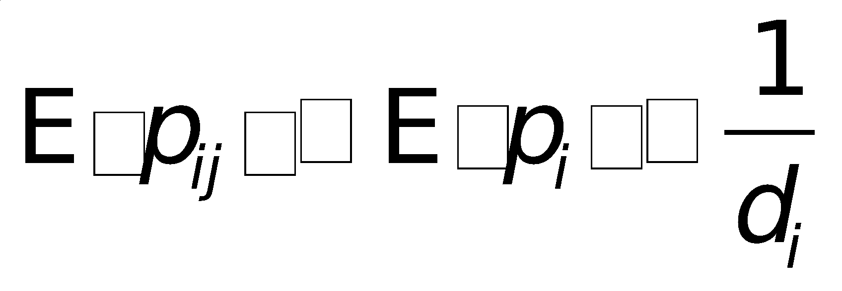
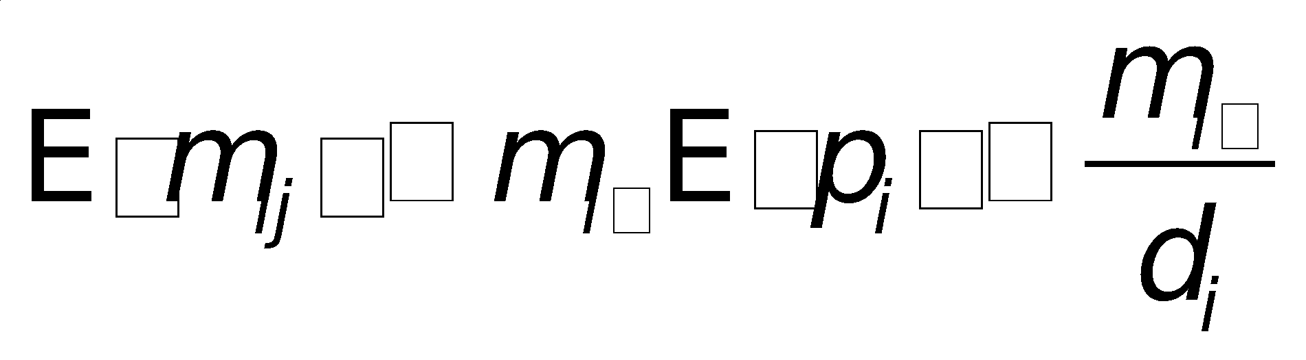
Nodal Degree and Arc Flows
2
5
1
3
3
1
4
Outflow smaller for larger degree nodes
Outflow larger for high vertex strength nodes
Caveat: d_{i} and m_{i+} correlated
‹#›
Notes:
‹#›
mij constrained by mi+:
mi+ stock (maybe a function of inflow from prior time period that has not yet flowed out)
mij flow
people with high vertex strength should have large outflows.
(1) EXCEPT: if they are high degree
Then have to distribute activity among a large number of others.
(2) EXCEPT when they over or under disperce
some think of a weak tie as min(mij) over all of i’s j neighbors.

Slide 9


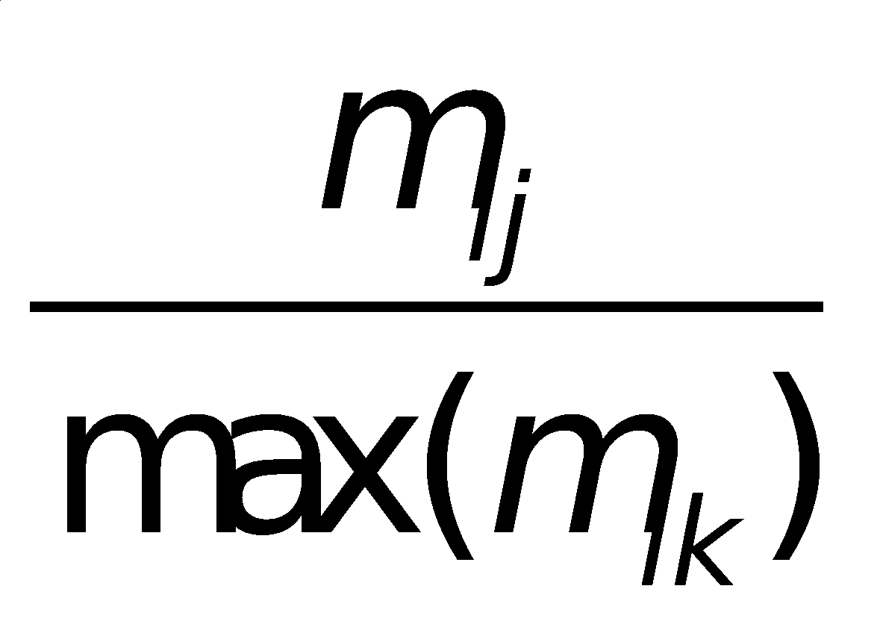
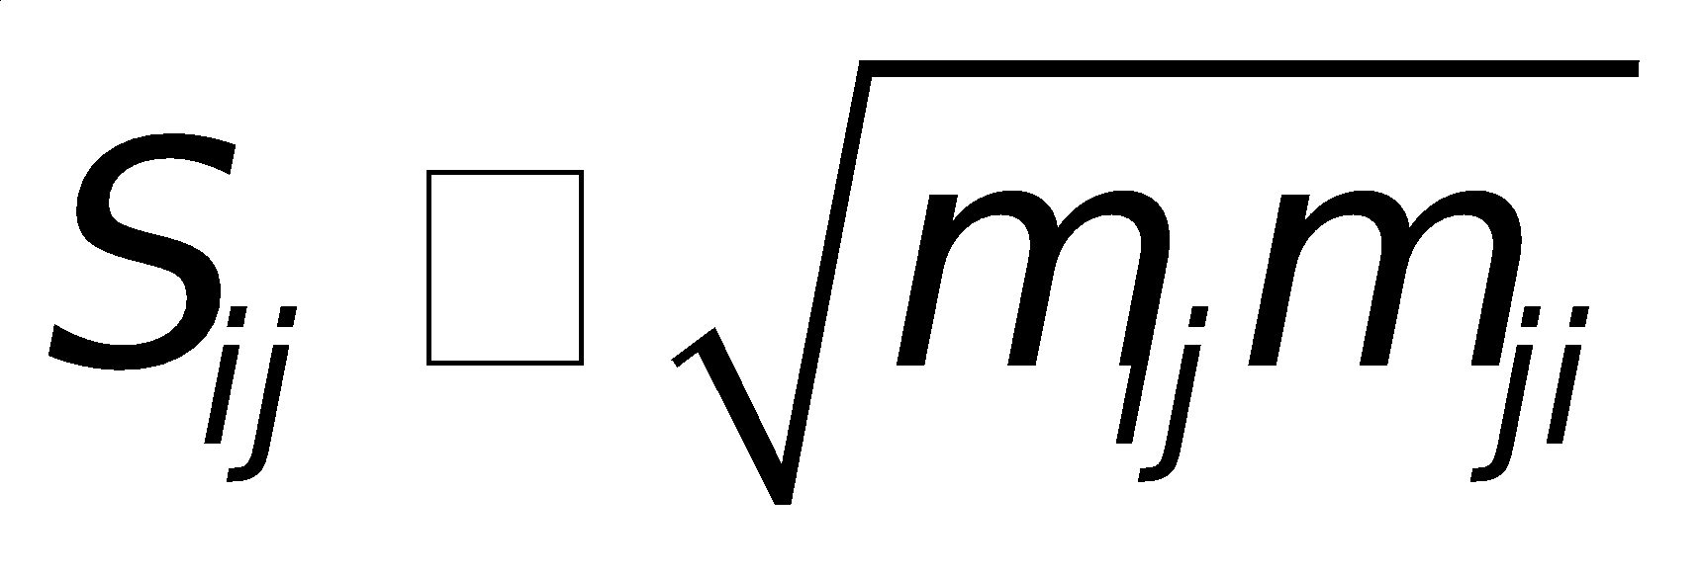
Tie (arc) Strength
Arc Strength
  Transition Probability
  Arc Flow
  Relative Strength
Dyadic (edge) strength (bandwidth)

Slide 10
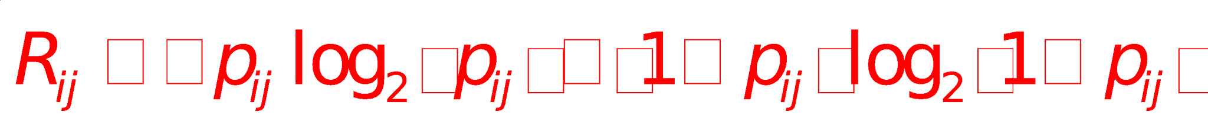
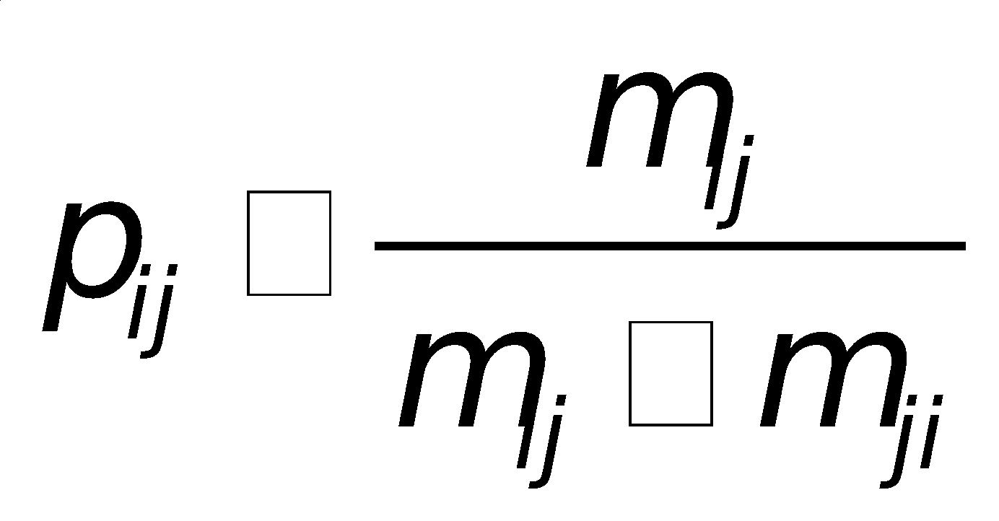
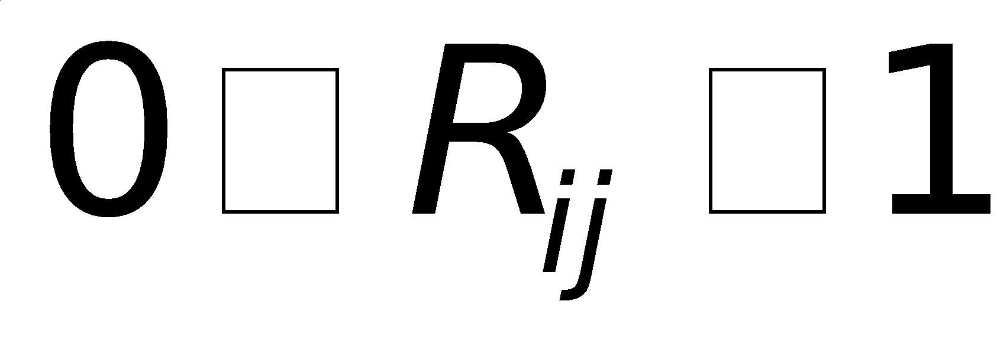
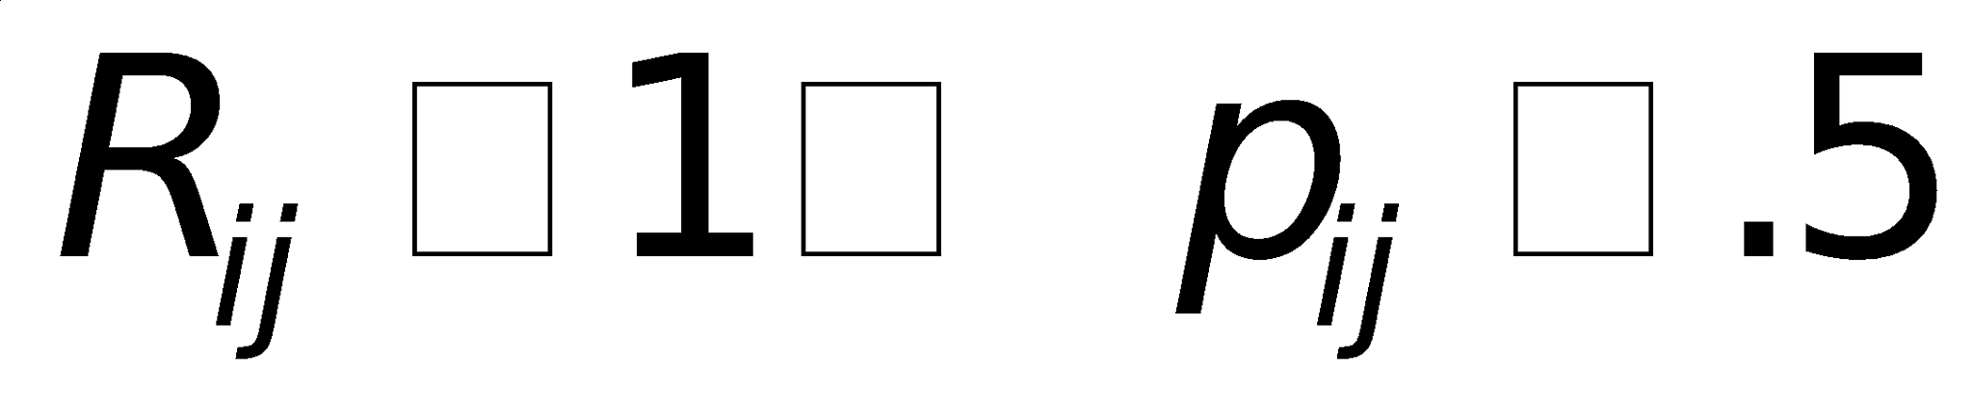
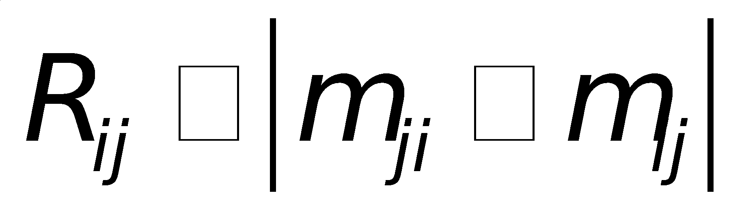
Reciprocity
where
Alternative Measure of Reciprocity
Notes:
‹#›
mi+ stock (maybe a function of inflow from prior time period that has not yet flowed out)
mij flow
dispersion like an error term, actors can over or under disperse from expected mij

Slide 11
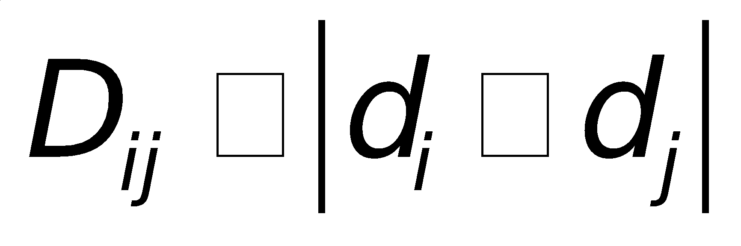
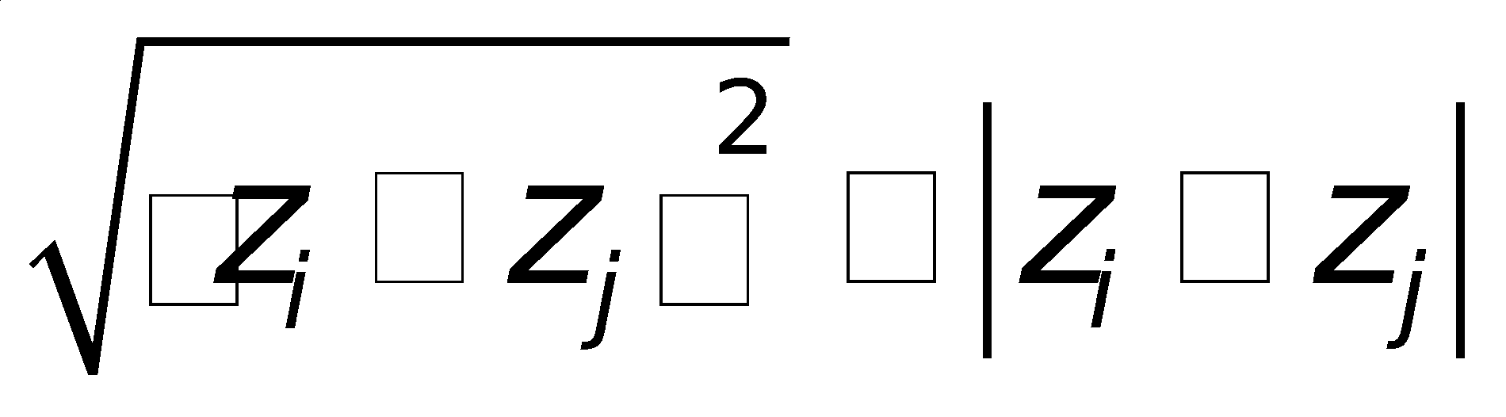
Assortative Mixing
Similarity/Difference between nodes (distance)
by Degree (degree assortativity)
Euclidian Distance (homophily)

